Slide 1
ASCE Concrete Canoe Competition
Jordan Cruz(PM)
Steve Godine
Kyle Plaza
Eric Weinberg
Advisors: Dr. Vedrana Krstic & Dr. Andrew Bechtel

Slide 2
Project Overview
Specifications
Team Management
Hull Design
Structural Analysis
Mix Design
Budget
Fundraising
Schedule

Slide 3
ASCE Concrete Canoe Competition
National Concrete Canoe Competition (NCCC)
Application of classroom skills + necessary career management skills in the field
Areas of Judgment
  Oral Presentation
  Design Paper
  Final Product

Slide 4
Problem Statement
General: Create a canoe that is suitable for transportation and competition
Design a suitable hull that will hold the required passengers
Design a concrete mix that will meet the structural requirements
Build a canoe in an efficient and timely manner
Document all processes gone through to complete the tasks

Slide 5
Team Management
Jordan Cruz – Project Manager, Application Process Selection
Steven Godine – Hull Design, Fundraising Chair
Kyle Plaza – Structural Analysis, Theme Selection
Eric Weinberg – Mix Design, Website Coordinator
The College of New Jersey Department of Civil Engineering

Slide 6
Important Specifications
Canoe Dimensions
  Max Length 22 feet
  Max Width 36 inches
Concrete Mix
  Mass of cement should be greater than 30% of total mass of concrete
  Water/cement ratio not specified
  Aggregates should be at least 25% of total volume
The College of New Jersey Department of Civil Engineering

Slide 7
Hull Design
Performance Characteristics
Straight Line Speed
Tracking
Maneuverability
Stability
  Primary
  Secondary
Resistance
  Coefficient of Friction
  Wetted Surface
  Velocity
The College of New Jersey Department of Civil Engineering

Slide 8
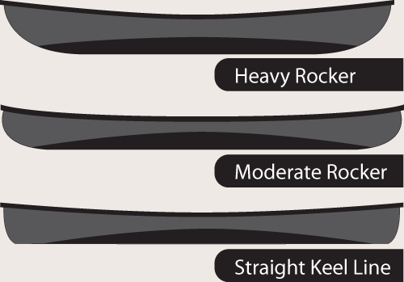
Hull Design
Key Parameters
Rocker
Length
Depth
Longitudinal Shape
Beam
Cross Sectional Shape
Draft
The College of New Jersey Department of Civil Engineering

Slide 9
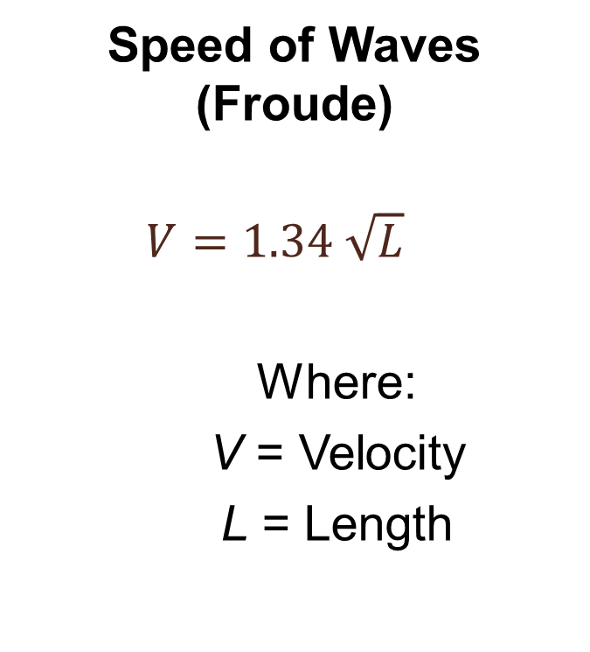
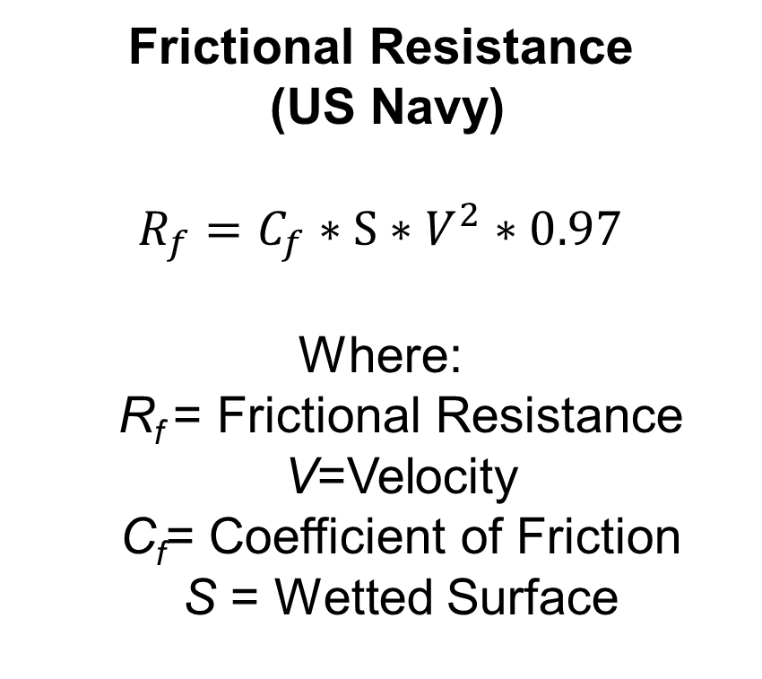
Hull Design
Speed of Waves (Froude)
  $$V=1.34 \sqrt{L}$$
    Where:
    V = Velocity
    L = Length
Frictional Resistance
(US Navy)
$R_{f}=C_{f}∗S∗V^{2}∗0.97$
Where:
  R_{f} = Frictional Resistance V=Velocity
  C_{f}= Coefficient of Friction
  S = Wetted Surface
The College of New Jersey Department of Civil Engineering

Slide 10
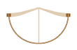

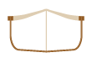
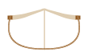
Hull Design
3 types of Cross Sectional Design
  Round bottom
  Flat bottom
  Shallow arch
Beam to Length Ratio
  (Typical value ~ 0.13)
Placement of the Maximum Beam
  55 % of way from the stern to bow
    Minimize turbulent flow
The College of New Jersey Department of Civil Engineering

Slide 11
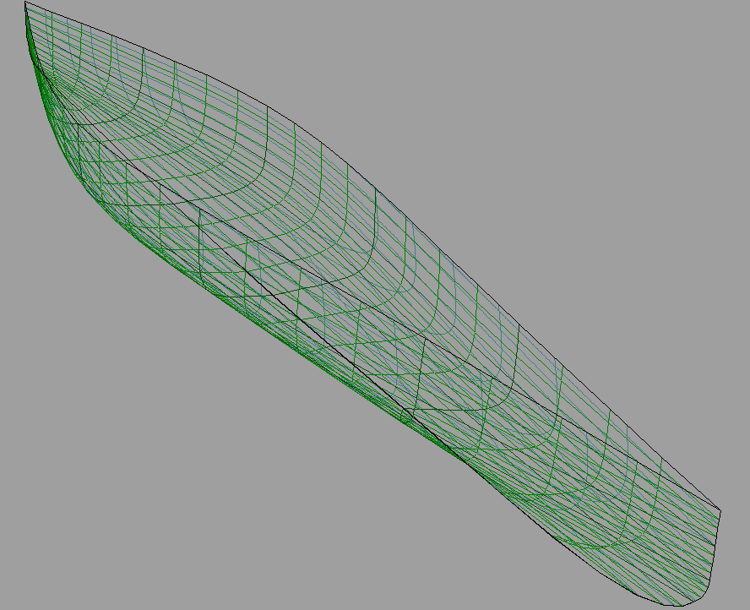
Hull Design
Free!Ship
Shallow Arch Cross Sectional Design
Length - 20.5 feet
Beam – 29.5 inches
Beam to Length Ratio - 0.123
Draft - 5.4 inches
The College of New Jersey Department of Civil Engineering

Slide 12
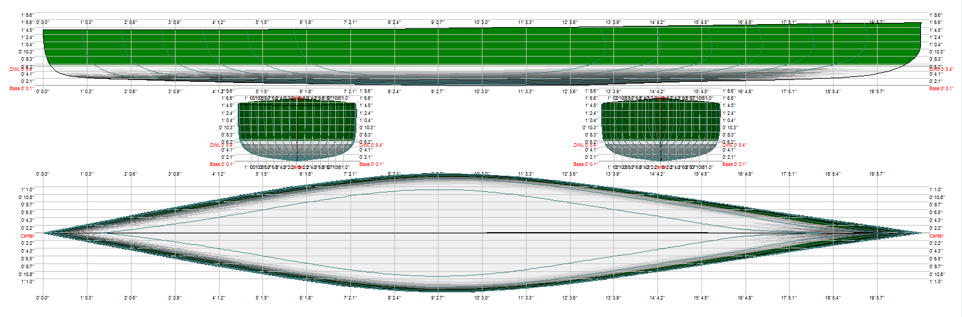
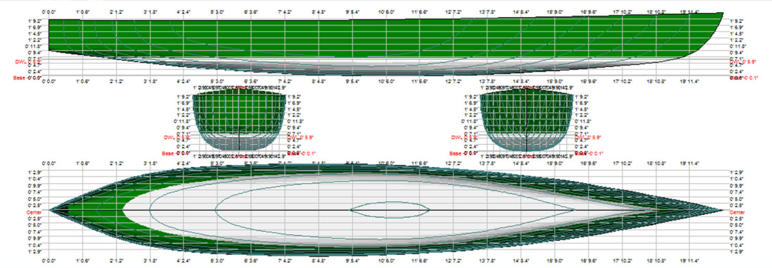
Jackpot (top) vs. Pumba (bottom)
Linesplan
Major Differences
Cross Section Shape
Length
Beam
Placement of maximum beam
Rocker
Depth
The College of New Jersey Department of Civil Engineering

Slide 13
Structural Specifications
Analyzed the canoe as a beam with symmetric point loads against a distributed buoyant force
Used an average weight of 160lbs for each scenario
Analyzed with a buoyant force of 31.22 lb./ft. (4 rowers)
Center of Gravity (x direction)= 10.04’ from stern
Center of Gravity (y direction) = 0’
Center of Gravity (z direction) = 0.577’ = 6.9”
The College of New Jersey Department of Civil Engineering

Slide 14
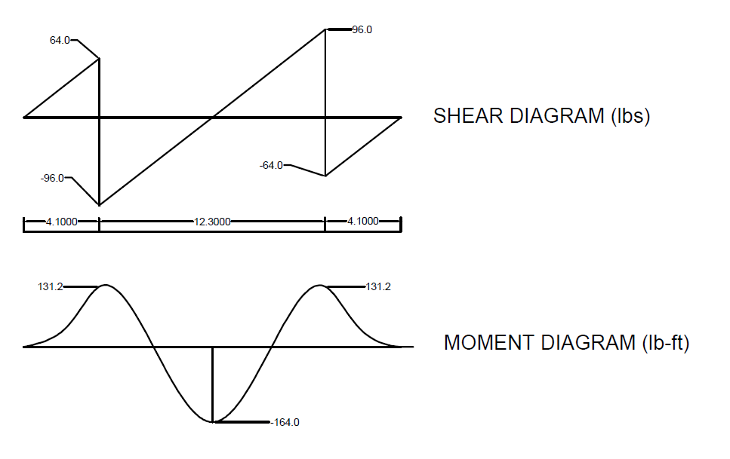
Structural Analysis
2 Rowers
The College of New Jersey Department of Civil Engineering

Slide 15
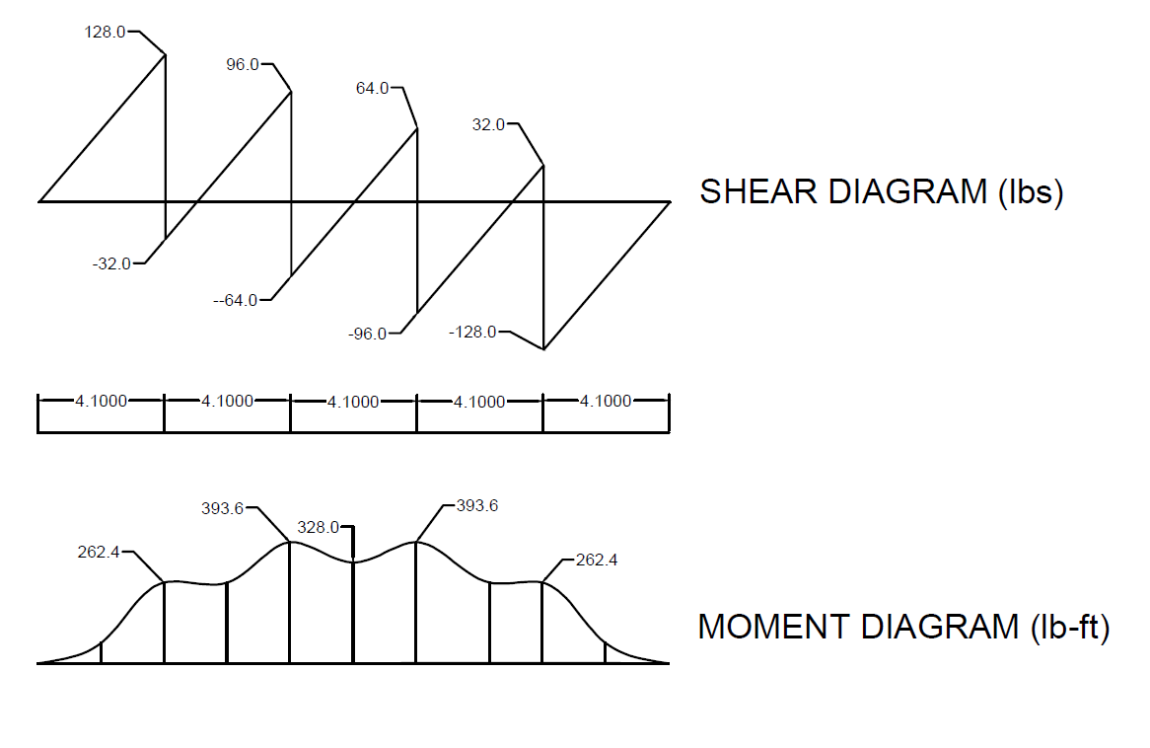
Structural Analysis
Simple Beam with 4 symmetric loads
The College of New Jersey Department of Civil Engineering

Slide 16
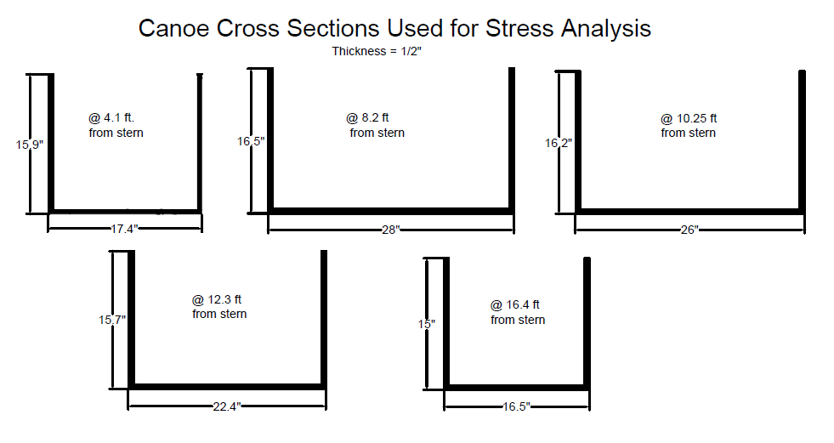
Structural Analysis
Cross Sections
The College of New Jersey Department of Civil Engineering

Slide 17
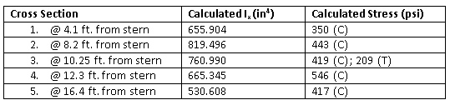
Structural Analysis
Stresses
The College of New Jersey Department of Civil Engineering

Slide 18
What is Shotcrete?
Invented in the 20th Century for taxidermy
Concrete is conveyed through a hose and pneumatically projected at high velocity onto a surface
Uses: infrastructure repair, slope stabilization, artificial rockscapes, swimming pools
Ease of application onto unique surfaces
The College of New Jersey Department of Civil Engineering

Slide 19
Shotcrete vs. Hand-Placement
Shotcrete
Hand-Placement
Self-compacting
  Increases the strength
Efficiency of placement for reinforcing fibers
Higher density due to loss of air voids
Smaller aggregate used in order to make the mix flowable
Water is added at the nozzle
Compacted and placed by many hands
Reinforcing fibers are applied in a 2D fashion
Density remains closer to theoretical density
Larger aggregate able to be used
Water is added with the batch before application
The College of New Jersey Department of Civil Engineering

Slide 20
Benefits and Drawbacks
Benefits
Drawbacks
Ease of Application
  Requires one nozzleman
Requires same amount of material as other methods
30-40% Increase in strength
Alignment of reinforcing fibers
Not widely used - Ingenuity!
Requires skilled nozzleman
  ASA Certified Nozzleman will be used
Requires specialized carousel hopper pump
Difficulty of keeping W/C ratio consistent
The College of New Jersey Department of Civil Engineering

Slide 21
Concrete and Application
Shotcrete
  Density
  Air content
Reinforcement
  PVA Fibers
Aggregates
  Poravers
  Glass bubbles
Cementitious materials
  Type I Portland Cement
  Class F Fly Ash
  Silica Fume
Admixtures
  Plastol 6400
  Eucon Retarder 100
  Visctrol
The College of New Jersey Department of Civil Engineering

Slide 22
Mix Design
Three mixes tested, to date
  Desired vs. Found Strength
Mix | 7 day strength (psi) | 28 day strength (psi) | Density (lb/ft³)
1 | 1046 | 1155 | 56.4
2 | 781 | 912 | 63.2
3 | 820 | 902 | 61.7
Expected | 1400 | 2000
The College of New Jersey Department of Civil Engineering

Slide 23
Shotcrete Mix
Material | Percent of Volume
Portland Cement | 5.9%
Fly Ash | 3.5%
Silica Fume | 4.0%
PVA Fibers | 1.6%
Porover | 7.2%
K25 | 36.5%
K37 | 16.4%
The College of New Jersey Department of Civil Engineering

Slide 24
Concrete Characteristics
Characteristic | Value
Mass of Concrete, lbs. | 1365.64
Absolute Volume of Concrete, ft³ | 25.39952
Theoretical Density, lb/ft³ | 53.76637
Air Content, % | 6.301221
Yield, ft³ | 27
The College of New Jersey Department of Civil Engineering

Slide 25



Team Theme
Casino
Name of the Boat: Jackpot
T-shirt Design
The College of New Jersey Department of Civil Engineering

Slide 26
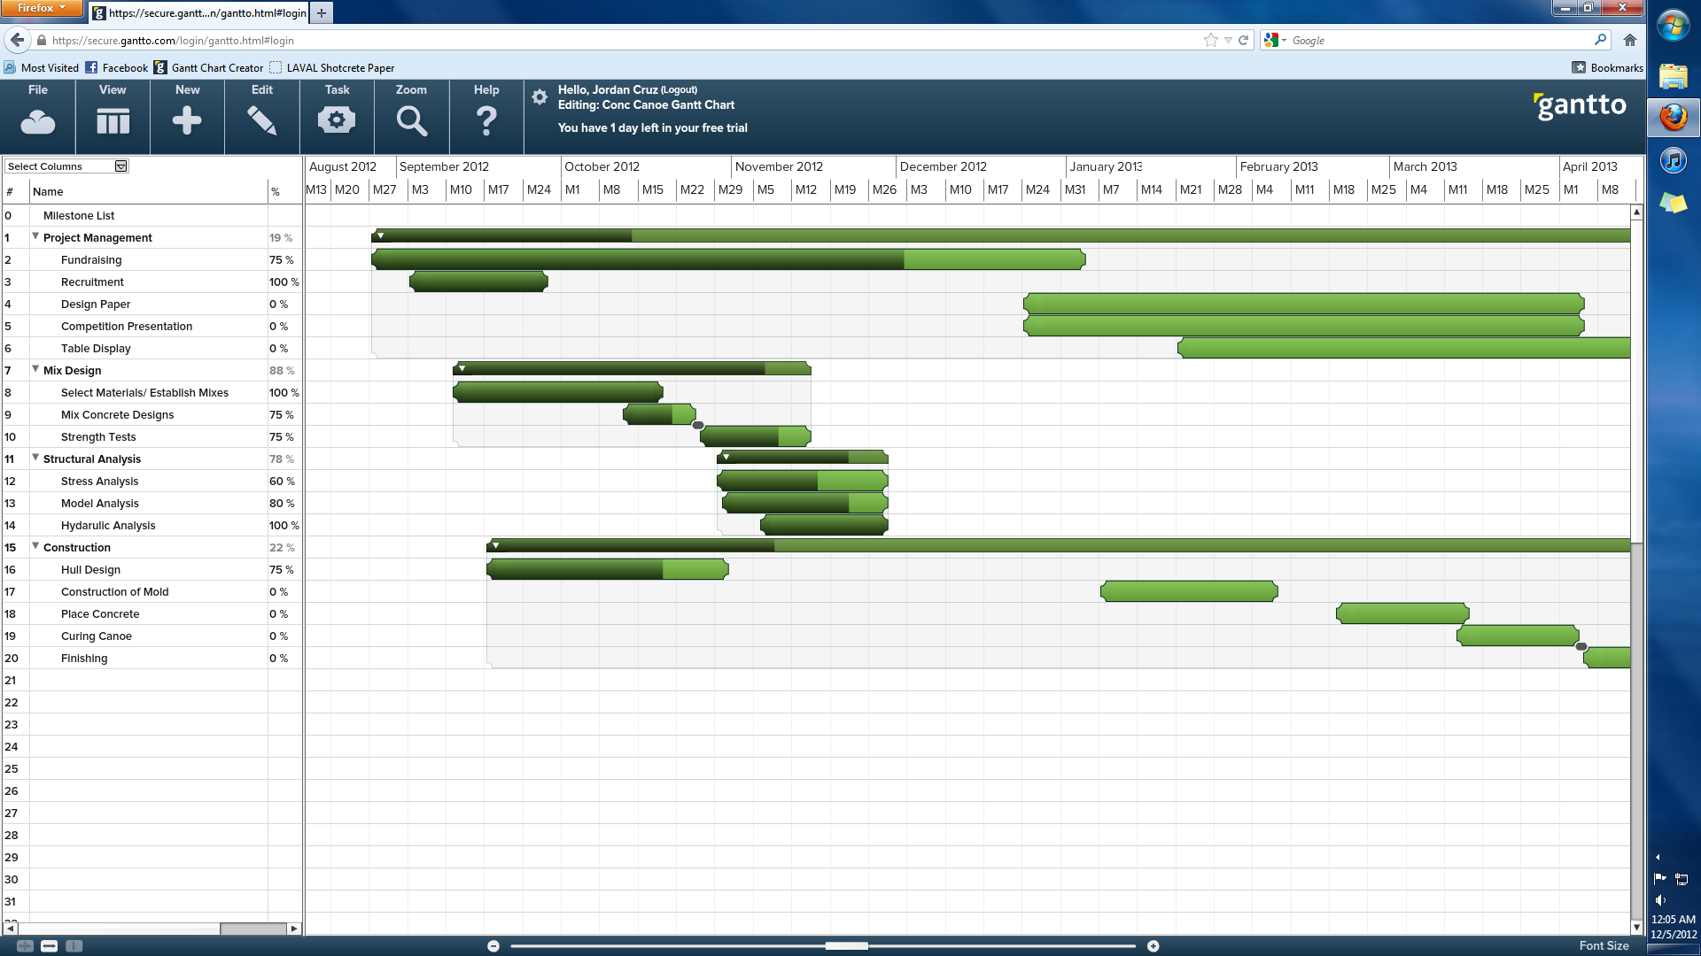
Schedule
The College of New Jersey Department of Civil Engineering

Slide 27
Budget
Styrofoam Mold | $2000
Registration (6 People) | $450 (School Funded)
Concrete Materials | $1000 (Donated)
T-shirts | $250 (Donated)
Transportation | School Funding
10% Contingency | $200
Total Cost | $2200
The College of New Jersey Department of Civil Engineering

Slide 28
Fundraising Efforts
$100 person from TCNJ
$800 from ASCE Central Branch
Fundraising
Concrete Canoe Glassware: $200
Lion’s Stadium Concession Stand: ~$150 and rising
Company Donations: $350
Total Fundraising to date: $1900
The College of New Jersey Department of Civil Engineering

Slide 29
Summary
Designed a hull and concrete mixes that will meet the specifications
Gained sponsorships from many companies and organizations
We will continue to explore fundraising opportunities
We will continue to make progress and move forward with our plan of action
The College of New Jersey Department of Civil Engineering

Slide 30
Questions?
The College of New Jersey Department of Civil Engineering

